Slide 1
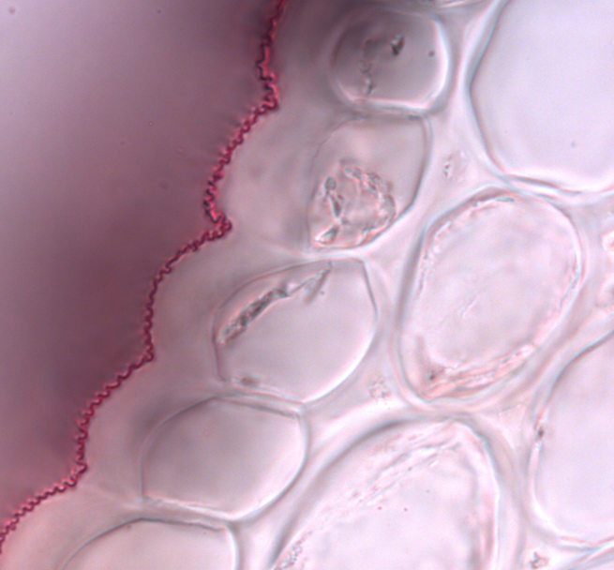
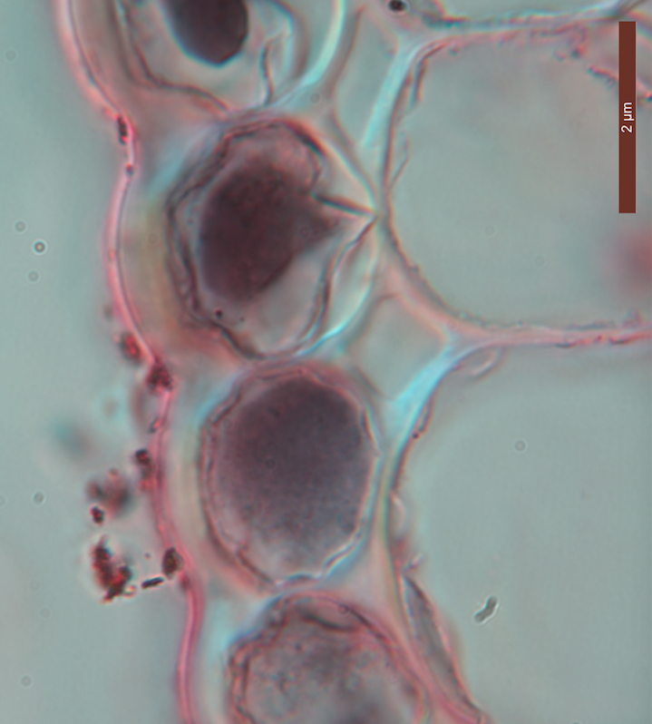
Characterization of transgenic plants with smooth flowers
Striated WT flowers:
Transgenics with smooth flowers:
WT
35S::SHN3::VP16
20um
20um
-Cuticle thickness
-Cell growth
-Stiffness (AFM)
-Chemistry LESA-MS

